Slide 1
Introduction to JavaScript– Basic Facts
PrePAred by anood nazeer

Slide 2
What is JavaScript?
Programming Language: It is a popular scripting language used for web development.
Interactive Web Pages: It makes websites dynamic and interactive (e.g., animations, pop-ups).
Client-Side & Server-Side: Works in browsers (client-side) and on servers (e.g., Node.js).
Event Handling: Responds to user actions like clicks, typing, and mouse movements.
Cross-Platform: Works on different devices and operating systems.
Lightweight & Fast: Executes quickly in the browser without requiring installation.
Versatile: Used for building web apps, games, and even mobile applications.

Slide 3
Why Study JavaScript?
Popular and In-Demand: Widely used in web development with high job demand.
Interactive Websites: Helps create dynamic and user-friendly web pages.
Versatile Language: Used for websites, web apps, mobile apps, and more.
Client and Server-Side: Works on both web browsers (front-end) and servers (back-end).
Easy to Learn: Beginner-friendly with many resources and a large community.
Career Opportunities: Opens doors to various tech careers like web development.
Modern Web Development: Essential for using frameworks like React, Angular, and Node.js.

Slide 4
What Can JavaScript Do?
Add Interactivity: Creates dynamic elements like pop-ups, sliders, and forms.
Manipulate Web Pages: Changes HTML and CSS to update content and style.
Handle Events: Responds to user actions like clicks, typing, and scrolling.
Validate Forms: Checks user input before sending data to the server.
Create Animations: Builds visual effects and smooth transitions.
Communicate with Servers: Sends and receives data without reloading the page (e.g., AJAX).
Build Applications: Used to develop web apps, mobile apps, and games.

Slide 5
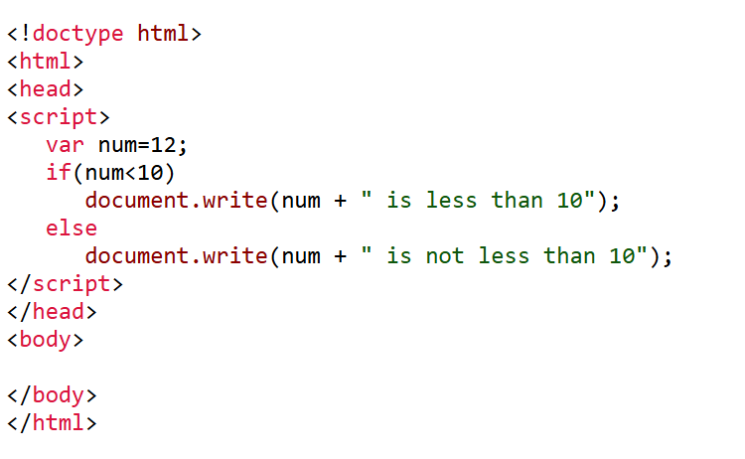
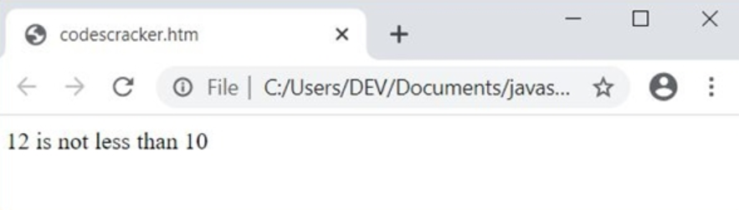
A simple javascript programe….
Output is……

Slide 6
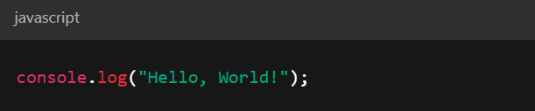
JavaScript syntax
JavaScript syntax is the set of rules that defines how JavaScript programs are written and understood by the computer
1. Statements
A statement is an instruction that performs an action.

Slide 7
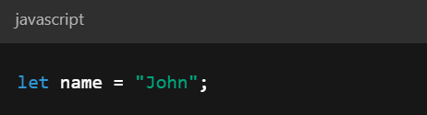
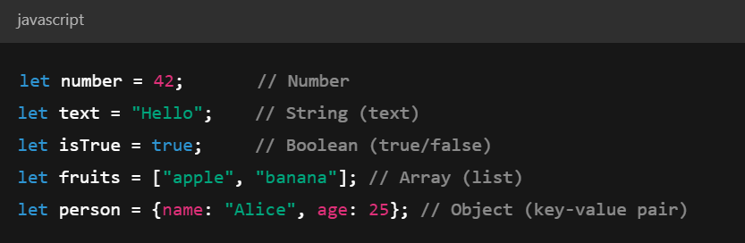
2. Variables
Variables store data (like numbers, text, etc.).
3. Data Types
JavaScript has different types of data:

Slide 8
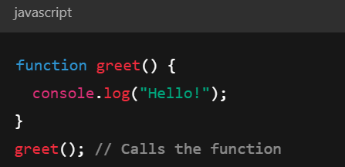
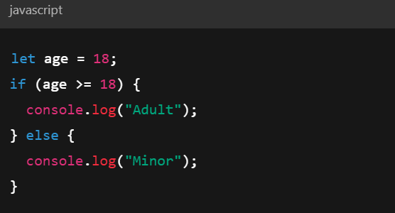
4. Functions
A function is a reusable block of code.
5. Conditions
If...else checks if something is true and decides what to do.

Slide 9
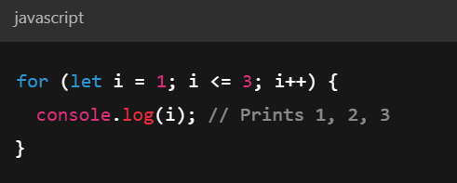
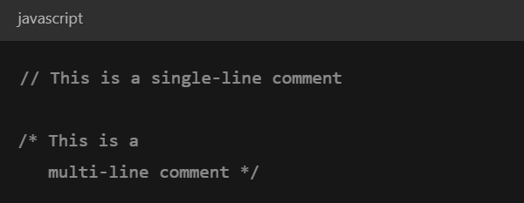
6. Loops
Loops repeat a block of code.
7. Comments
Comments explain your code (ignored by the computer).

Slide 10
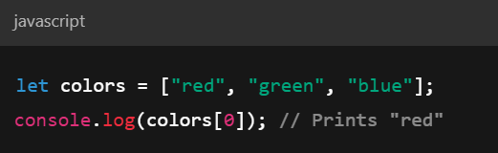
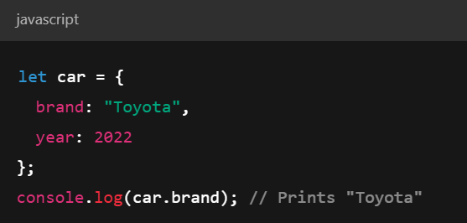
8. Arrays
Store a list of values.
9. Objects
Store related data together.

Slide 11
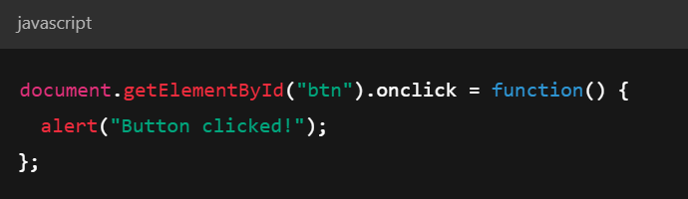
10. Events
React to user actions (like clicks).

Slide 12
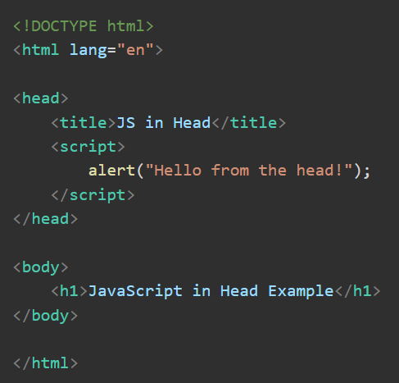
where to place javascript in html?
1. Inside the <head> section
JavaScript in the <head> section is useful for functions needed before the page loads.

Slide 13
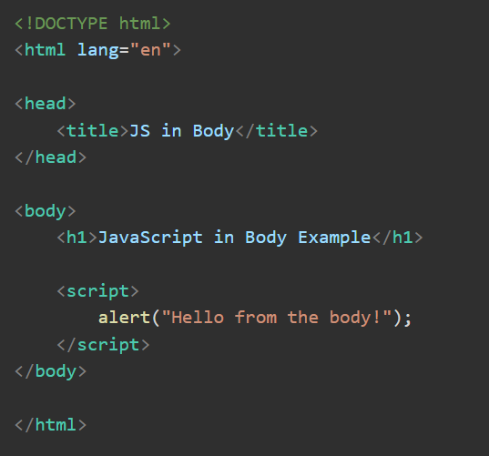
2. Inside the <body > section
Place JavaScript here if you want to run it as the page loads.

Slide 14
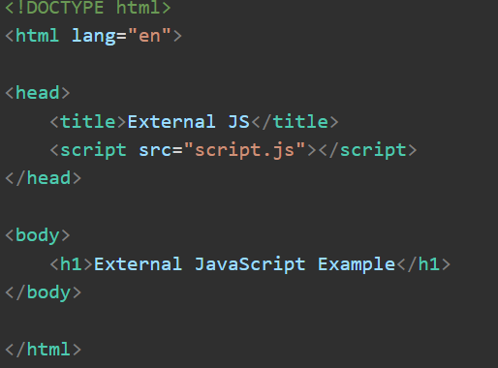
3. External JavaScript File
Best for keeping your HTML clean by linking to a separate .js file.
How It Works:
The HTML page loads.
The browser reads and runs the code inside script.js.
An alert box appears, and a message is logged in the console.

Slide 15
Advantages of External JavaScript:
✅ Cleaner Code: Keeps HTML and JavaScript separate.
✅ Reusability: Use the same script on multiple pages.
✅ Better Performance: HTML loads first, scripts later.

Slide 16
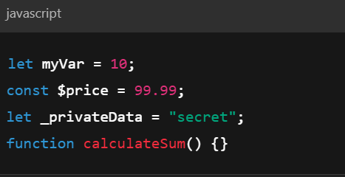
JavaScript Identifiers
Identifiers in JavaScript are the names you give to variables, functions, objects, and other entities. They follow specific rules and conventions.
Valid Identifiers

Slide 17
Rules for JavaScript Identifiers
Allowed Characters: Identifiers can include:
Letters (a-z, A-Z)
Digits (0-9) – but cannot be the first character
Underscores (_)
Dollar signs ($)
Cannot Start with a Number: ✅ Valid: name1 ❌ Invalid: 1name
Case-Sensitive:
myVariable and myvariable are different.
No Reserved Keywords:
You cannot use JavaScript reserved words like let, function, class, if, etc.

Slide 18
JavaScript keywords
✅ Variable Declaration Keywords
var – Used to declare a variable (e.g., var name = "John";).
let – Declares a variable with block scope (e.g., let age = 25;).
const – Declares a constant value (e.g., const pi = 3.14;).
✅ Function and Class Keywords
function – Declares a function (e.g., function greet() { ... }).
return – Sends a value from a function (e.g., return "Hello";).
class – Defines a class (e.g., class Car { constructor() { ... } }).
extends – Inherits from another class (e.g., class ElectricCar extends Car { ... }).

Slide 19
✅ Control Flow Keywords
if – Runs code if a condition is true (e.g., if (age > 18) { ... }).
else – Runs code if the condition is false (e.g., else { ... }).
switch – Checks multiple cases (e.g., switch(day) { case "Monday": ... }).
for – Loops through code (e.g., for (let i = 0; i < 5; i++) { ... }).
while – Loops while a condition is true (e.g., while (x < 10) { ... }).
break – Stops a loop (e.g., break;).
continue – Skips to the next loop iteration (e.g., continue;).

Slide 20
✅ Error Handling Keywords
try – Tests a block of code (e.g., try { ... }).
catch – Handles errors (e.g., catch (error) { ... }).
throw – Manually throws an error (e.g., throw "Error!";).
✅ Object and Module Keywords
this – Refers to the current object (e.g., this.name = "Car";).
new – Creates a new object (e.g., let car = new Car();).
import – Imports from another module (e.g., import { sum } from './math.js';).
export – Shares code with other files (e.g., export function add() { ... }).

Slide 21
JavaScript values
In JavaScript, values are the data that variables hold or represent. These values fall into two main categories: primitive and non-primitive.
✅ 1. Primitive Values
(Simple values that cannot be changed.)
Number – Represents numeric data. 👉 Example: let age = 25;
String – Represents text. 👉 Example: let name = "John";
Boolean – Represents true or false. 👉 Example: let isHappy = true;
Undefined – A variable with no assigned value. 👉 Example: let color;
Null – Represents no value or an empty value. 👉 Example: let car = null;
BigInt – Holds very large numbers. 👉 Example: let bigNumber = 12345678901234567890n;
Symbol – A unique value used for object properties. 👉 Example: let id = Symbol('id');

Slide 22
✅ 2. Non-Primitive (Reference) Values
Object – Stores data in key-value pairs.
let person = { name: "Alice", age: 30 };
. Array – Holds an ordered list of items
let fruits = ["apple", "banana", "cherry"];
Function – A reusable block of code.
function greet() {
return "Hello!";
}
Date – Represents a date and time.
let today = new Date();

Slide 23
Var, let const
let – Block-scoped, can be updated but not re-declared.
const – Block-scoped, cannot be updated or re-declared (for primitive values).
var – Function-scoped, can be re-declared and updated.

Slide 24
Scope in JavaScript
Scope in JavaScript defines where variables and functions can be accessed in your code. It comes in three types:
Global Scope – Accessible anywhere in the code.
Function Scope – Accessible only inside the function where it's declared.
Block Scope – Accessible only within the block {} where it's defined (with let and const).

Slide 25
JavaScript Hoisting & Variable Hoisting:
JavaScript Hoisting:
It is the process where variable and function declarations are moved to the top of their scope during execution.
Variable Hoisting:
In JavaScript, variables declared with:
var are hoisted and initialized as undefined.
let and const are hoisted but not initialized, causing a Reference Error if accessed before declaration

Slide 26
Conclusion
JavaScript is a powerful and versatile programming language for web development.
Understanding variables, scope, hoisting, and data types is essential for writing efficient code.
Concepts like let, const, var, functions, and event handling help build interactive web applications.
Mastering the basics lays a strong foundation for advanced JavaScript topics like DOM manipulation, asynchronous programming, and frameworks.

